Slide 1


Smart Contract Development With Solidity
Intro to Ethereum and Smart Contracts
SoftUni Team
Technical Trainers
Software University
http://softuni.bg

Slide 2
Questions
sli.do #SContracts

Slide 3

Table of Contents
Ethereum Transactions - structure and types
Smart Contracts Compilation
ABI (Application Binary Interface)
Ethereum Virtual Machine
Gas & Gas Limit
Overall Pros/Cons
Solidity Overview
Write Simple Smart Contract
Solidity Datatypes

Slide 4
Ethereum Transaction Structure
A transaction (tx) contains 6 input fields:
nonce – the number of outgoing transactions (starting with 0)
gasPrice – the price to determine the amount of Ether the transaction will cost
to – the account the transaction is sent to, if empty, the transaction will create a contract
value – the amount of Ether to send (measured in Wei)
data – could be an arbitrary message or function call to a contract or code to create a contract

Slide 5
Ethereum Transaction Structure
An executed tx returns a tx receipt (the outcome of a tx):
used resources
block number/hash; tx hash
contract related data (if any)

Slide 6
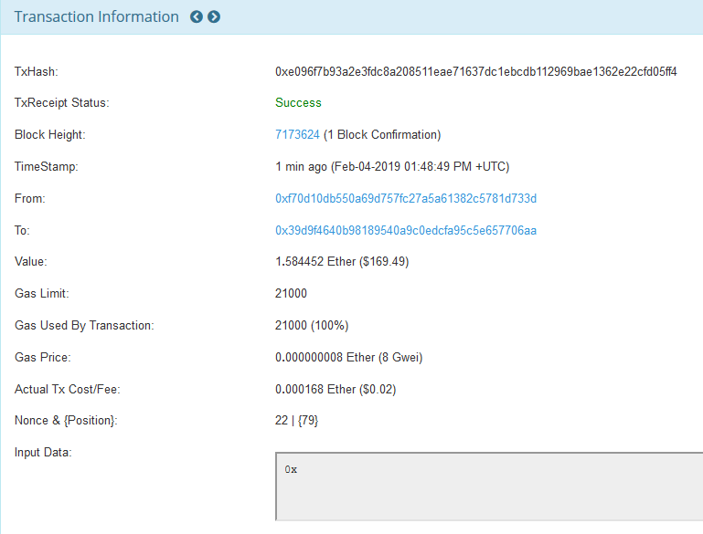
Ethereum Transaction Structure

Slide 7
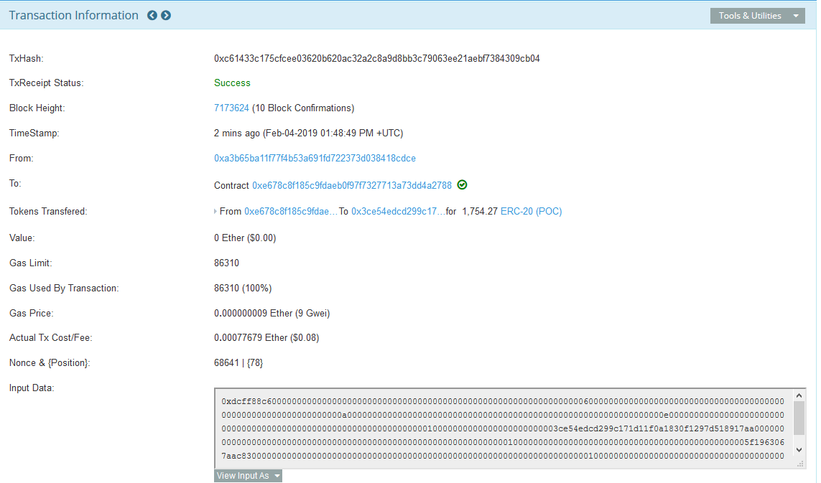
Ethereum Transaction Structure

Slide 8
Ethereum Denominations
1 | 1 | Ether
1,000 | 10³ | Finney
1,000,000 | 10⁶ | Szabo
1,000,000,000 | 10⁹ | Gwei
1,000,000,000,000 | 10¹² | Mwei
1,000,000,000,000,000 | 10¹⁵ | Kwei
1,000,000,000,000,000,000 | 10¹⁸ | Wei

Slide 9

Smart Contract Compilation
Bytecode
(EVM instructions)
Solc compiler
ABI definition
Ethereum Virtual Machine (EVM) is the environment where contracts are executed.
The Application Binary Interface (ABI) contains info about the contract’s interface:

Slide 10
Smart Contract Compilation
Bytecode
(EVM instructions)
Ethereum blockchain
ABI definition
Accessing the contract
To publish the contract, the bytecode is uploaded to the blockchain
To access it (call its methods or read its memory), you need the ABI definition to know what inputs and outputs the contract operates with

Slide 11
Application Binary Interface
a list of the contract's functions and arguments (in JSON format)
the standard way to interact with contracts in the Ethereum ecosystem
how to read the data out of transactions
the ABI decoder is automatically generated by the Solidity compiler

Slide 12
ABI Example
contract Foo {
function bar(uint32, bool) public {}
}
"inputs": [
{
"name": "",
"type": "uint32"
},
{
"name": "",
"type": "bool"
}
],
"name": "bar“,
“type": “function“

Slide 13
Contract Deployment
A contract has to be uploaded to the blockchain
(a.k.a. deployed)
When published, the contract’s initializing code is run (its constructor)
Contract deployment is a transaction
With no recipient (null)
With the contract’s compiled bytecode as tx data
The tx receipt contains the contract address
Must be used to locate the contract

Slide 14

Contract Execution
Is a call of a public contract function
Is a transaction
With the contract address as recipient
With ID and inputs of the called function as tx data

Slide 15
Contract Execution
If we want to call bar() with the parameters 43 and true, we would pass 68 bytes total which can be broken into:
0x84db1c19: Method ID. This is derived as the first 4 bytes of the Keccak hash of the ASCII form of the signature: bar(uint32, bool)
0x000000000000000000000000000000000000000000000000000000000000002B: the first parameter, a uint32 value 43 padded to 32 bytes
0x0000000000000000000000000000000000000000000000000000000000000001: the second parameter - boolean true, padded to 32 bytes
In total:
0x84db1c19000000000000000000000000000000000000000000000000000000000000002B0000000000000000000000000000000000000000000000000000000000000001

Slide 16
Ethereum Virtual Machine
all full nodes in the Ethereum network agree to run
an interpreter for the Ethereum’s assembly language
EVM can be thought as a single powerful computer
simple deterministic state machine
computation is done using a stack-based bytecode language
Example:
PUSH1 0 CALLDATALOAD SLOAD NOT PUSH1 9 JUMPI STOP
Notes:
the state at the start is:
PC: 0 STACK: [] MEM: [], STORAGE: {}
The instruction at position 0 is PUSH1, which pushes a one-byte value onto the stack and jumps two steps in the code. Thus, we have:
PC: 2 STACK: [0] MEM: [], STORAGE: {}
The instruction at position 2 is CALLDATALOAD, which pops one value from the stack, loads the 32 bytes of message data starting from that index, and pushes that on to the stack. Recall that the first 32 bytes here encode 54.
PC: 3 STACK: [54] MEM: [], STORAGE: {}
SLOAD pops one from the stack and checks if there is a value in storage for the key popped from the stack. If so, it pushes the value into the stack at the current index. Since the contract is used for the first time, the storage is empty and no value is found for the popped key. Therefore, SLOAD pushes zero to the stack.
PC: 4 STACK: [0] MEM: [], STORAGE: {}
NOT pops one value and pushes 1 if the value is zero, else 0
PC: 5 STACK: [1] MEM: [], STORAGE: {}
Next, we PUSH1 9.
PC: 7 STACK: [1, 9] MEM: [], STORAGE: {}
The JUMPI instruction pops 2 values and jumps to the instruction designated by the first only if the second is nonzero. Here, the second is nonzero, so we jump. If the value in storage index 54 had not been zero, then the second value from top on the stack would have been 0 (due to NOT), so we would not have jumped, and we would have advanced to the STOP instruction which would have led to us stopping execution.
PC: 9 STACK: [] MEM: [], STORAGE: {}

Slide 17
Ethereum Virtual Machine
pragma solidity >=0.4.22 <0.6.0;
contract Greeter {
function greet ()
public
pure
returns (string memory) {
return “HelloWorld”;
}
}

Slide 18
Ethereum Virtual Machine
PUSH1 0x80 PUSH1 0x40 MSTORE CALLVALUE DUP1 ISZERO PUSH2 0x10 JUMPI PUSH1 0x0 DUP1 REVERT JUMPDEST POP PUSH2 0x139 DUP1 PUSH2 0x20 PUSH1 0x0 CODECOPY PUSH1 0x0 RETURN INVALID PUSH1 0x80 PUSH1 0x40 MSTORE PUSH1 0x4 CALLDATASIZE LT PUSH2 0x3B JUMPI PUSH1 0x0 CALLDATALOAD PUSH29 0x100000000000000000000000000000000000000000000000000000000 SWAP1 DIV DUP1 PUSH4 0x942AE0A7 EQ PUSH2 0x40 JUMPI JUMPDEST PUSH1 0x0 DUP1 REVERT JUMPDEST CALLVALUE DUP1 ISZERO PUSH2 0x4C JUMPI PUSH1 0x0 DUP1 REVERT JUMPDEST POP PUSH2 0x55 PUSH2 0xD0 JUMP JUMPDEST PUSH1 0x40 MLOAD DUP1 DUP1 PUSH1 0x20 ADD DUP3 DUP2 SUB DUP3 MSTORE DUP4 DUP2 DUP2 MLOAD DUP2 MSTORE PUSH1 0x20 ADD SWAP2 POP DUP1 MLOAD SWAP1 PUSH1 0x20 ADD SWAP1 DUP1 DUP4 DUP4 PUSH1 0x0 JUMPDEST DUP4 DUP2 LT ISZERO PUSH2 0x95 JUMPI DUP1 DUP3 ADD MLOAD DUP2 DUP5 ADD MSTORE PUSH1 0x20 DUP2 ADD SWAP1 POP PUSH2 0x7A JUMP JUMPDEST POP POP POP POP SWAP1 POP SWAP1 DUP2 ADD SWAP1 PUSH1 0x1F AND DUP1 ISZERO PUSH2 0xC2 JUMPI DUP1 DUP3 SUB DUP1 MLOAD PUSH1 0x1 DUP4 PUSH1 0x20 SUB PUSH2 0x100 EXP SUB NOT AND DUP2 MSTORE PUSH1 0x20 ADD SWAP2 POP JUMPDEST POP SWAP3 POP POP POP PUSH1 0x40 MLOAD DUP1 SWAP2 SUB SWAP1 RETURN JUMPDEST PUSH1 0x60 PUSH1 0x40 DUP1 MLOAD SWAP1 DUP2 ADD PUSH1 0x40 MSTORE DUP1 PUSH1 0xA DUP2 MSTORE PUSH1 0x20 ADD PUSH32 0x48656C6C6F576F726C6400000000000000000000000000000000000000000000 DUP2 MSTORE POP SWAP1 POP SWAP1 JUMP INVALID LOG1 PUSH6 0x627A7A723058 KECCAK256 0xab EXTCODECOPY DUP7 0xa5 DUP14 0xe7 0x47 LOG1 STOP 0xe5 PUSH26 0x4501244A4347870B0E4FD36DD0B4EA6F7C2F5834FA0029000000

Slide 19

Gas – Fuel of the Blockchain
Contracts aren’t free!
Gas is not another currency
Gas is a measurement unit of complexity of the transaction
Example: Add or subtract two integers 1 million times costs 3,000,000 Gas
Gas price:
Dynamic
https://ethgasstation.info/

Slide 20
Gas Payments
Gas is measured and paid for each contract operation
Every transaction to a contract or contract creation
The gas price is set by the caller (you)
Too low and miners will ignore your tx!
The lower the price, the more time it will take for a miner to include the tx in a block
All transactions cost 21000 Gas as a base
Operations in Ethereum cost gas_price * gas_used

Slide 21
Is it Really Expensive?
add two numbers together 1 million times
4 Gwei * 3,000,000 = 0.012 ETH = ~ $1.32
add two numbers together 1 million times in Python in 0.04 seconds
Amazon charges $0.0059/hour for their cheapest EC2 instance
$0.000000066 for the operation
Compared to $1.32 it’s 20 million times more expensive

Slide 22

Gas Limit
Maximum allowed gas usage in a block
-> sum of all gas spendings of all TXs in the block
-> it is also maximum allowed gas spendings in a single TX
The block creator can change the limit by a small factor
Do not reach the limit!
Current contract execution will be terminated
Any changes to the contract’s state will be reverted

Slide 23

Operations That Cost Gas
Anything that changes the blockchain state:
Writing to contract’s memory
Execution of contract logic
Uploading data to blockchain (contract publishing)

Slide 24

Free Operations
Anything not requiring changes, like:
Reading blockchain data (contracts, their memory, …)
A contract staying on the blockchain

Slide 25
Beware! Easy to Hit the Limit
Do not, if possible:
Write code with loops (no guarantee that gas won’t run out)
Recursion (function calling itself)
Create large contracts (may not even publish)
We’ll have a full lecture on optimizing later, but keep these in mind.

Slide 26

Publicity
Everything on the blockchain is public
Code (compiled) and any contract variables
Can be used to find security holes in our contracts!
All contracts, accounts, balances, transactions, ...

Slide 27

Smart Contract Pros
The blockchain guarantee
100% uptime
No censorship or control
Completely autonomous
Unlimited life
Easily accessible (no need for servers)
Easy to develop (depends on the use case)
Easy to use (but sometimes costly)
Like a law

Slide 28

Smart Contract Cons
Gas expenses
Can get expensive
Gas limit
Limits what can be done
Publicity
Cannot be hidden
Blockchain limitations
No internet access

Slide 29
Solidity Overview
contract oriented
high-level language
statically typed
influenced by C++, Python and JavaScript
supports inheritance, libraries and complex user-defined types

Slide 30

Let’s Build a Hello World Contract!

Slide 31
Hello World
The whole contract:
pragma solidity >=0.4.22 <0.6.0;
contract Greeter {
function greet ()
public
pure
returns (string memory) {
return “HelloWorld”;
}
}

Slide 32
The “pragma” Line
Defines the version of the solidity language this was developed in
Important! A contract should not be compiled with newer Solidity versions without proper testing!
New versions may introduce compiler bugs!
pragma solidity >=0.4.22 <0.6.0;

Slide 33
The Contract Definition
Defines a contract with a name.
Similar to defining a class in OOP languages
The contract contains data and the logic to operate
contract Greeter {
// functions, variables, …
}

Slide 34
The Function Definition
Defines a publicly accessible function greet with no input arguments that returns one value of type string.
The syntax of input arguments is the same as in C#
The return values can be multiple and their types are specified in parentheses
function greet() returns (string memory)

Slide 35
The Return Statement
Returns the expected string
return “Hello world”;

Slide 36

Let’s write the contract at http://remix.ethereum.org

Slide 37
Solidity Type of Variables
Variable | Description
bool | it can hold true or false
int / uint | represent integers or numeric values unsigned cannot hold negative numbers.
address | represents a 20-byte value, which is meant to store the Ethereum address.
string | dynamically-sized string
bytes | dynamically-sized array
bytes1 through 32 | fixed-size byte array
mapping | hash table that have key and value
struct | allow programmers to define new types

Slide 38
Solidity Primitives
bool isActive = true;
// x**y is x to the power of y
int256 counter = 2**200;
// unsigned version of int
uint128 counter = 2**100 – 3;
uint8 state = 3;
//the “int” from C# is 32 bit
int32 reward = 23154;

Slide 39
Boolean Operations
! (logical negation)
&& (logical conjunction, “and”)
|| (logical disjunction, “or”)
== (equality)
!= (inequality)
<=, <, ==, !=, >=, > (comparisons)

Slide 40
Arithmetic Operations
+ - (add, sub)
++ -- (increment, decrement
* / (mul, div)
% (remainder)
** (exponentiation, works only with unsigned numbers)
= += -= /= *= (assignments)
>> right shift
<< left shift

Slide 41
Explicit casting
Any primitive type can be explicitly cast to another to be used temporarily in an expression
May cause overflow!
When a type’s max or min values are surpassed

Slide 42
Global Special Variables and Units
wei, finney, szabo, ether – auto conversion between subdenominations of Ether.
second, minute, hour, days, weeks, years – be careful with leap years

Slide 43
Block and Transaction Properties
block.blockHash: hash of the given block (only 256 most recent)
block.coinbase: current block miner’s address
block.difficulty: current block difficulty
block.gaslimit: current block gas limit
block.number: current block number
block.timestamp: current block timestamp

Slide 44
Block and Transaction Properties
msg.data: complete call data
msg.gas: remaining gas
msg.sender: sender of the message
msg.sig: first 4 bytes of the call data
msg.value: number of wei sent with the message
now: current block timestamp
tx.gasprice: gas price of the transaction
tx.origin: sender of the transaction

Slide 45
Loops
The loops and if and statement in solidity are the same as in C++, C#, Java, …
Avoid loops with unknown number of iterations at all costs!

Slide 46

Let’s Write a Decentralized Counter

Slide 47
Interesting content
https://docs.google.com/spreadsheets/d/1m89CVujrQe5LAFJ8-YAUCcNK950dUzMQPMJBxRtGCqs
https://hackernoon.com/ethereum-turing-completeness-and-rich-statefulness-explained-e650db7fc1fb
https://medium.com/@codetractio/inside-an-ethereum-transaction-fa94ffca912f

Slide 48
https://softuni.bg/trainings/courses

Slide 49











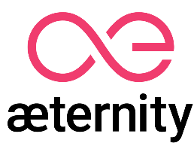

SoftUni Diamond Partners

Slide 50





SoftUni Organizational Partners

Slide 51




Trainings @ Software University (SoftUni)
Software University – High-Quality Education and Employment Opportunities
softuni.bg
Software University Foundation
http://softuni.foundation/
Software University @ Facebook
facebook.com/SoftwareUniversity
Software University Forums
forum.softuni.bg

Slide 52

License
This course (slides, examples, demos, videos, homework, etc.) is licensed under the "Creative Commons Attribution-NonCommercial-ShareAlike 4.0 International" license

